Slide 1

Machine Learning
Predicting - Churn
Gal Avizoor – 200866226
Email – Avizoor.gal@gmail.com

Slide 2

The Problem
Prediction: We are trying to predict whether a customer will churn or not (classify each new customer).
Available Dataset: Historical churn data which include number of features i.e. contract types, charges (total and monthly), tenure, payment methods, services and more.
Motivation / Application: To minimize the number of churned customers. In essence , classify customers whether they will churn or not and see what features most influence this action.

Slide 3
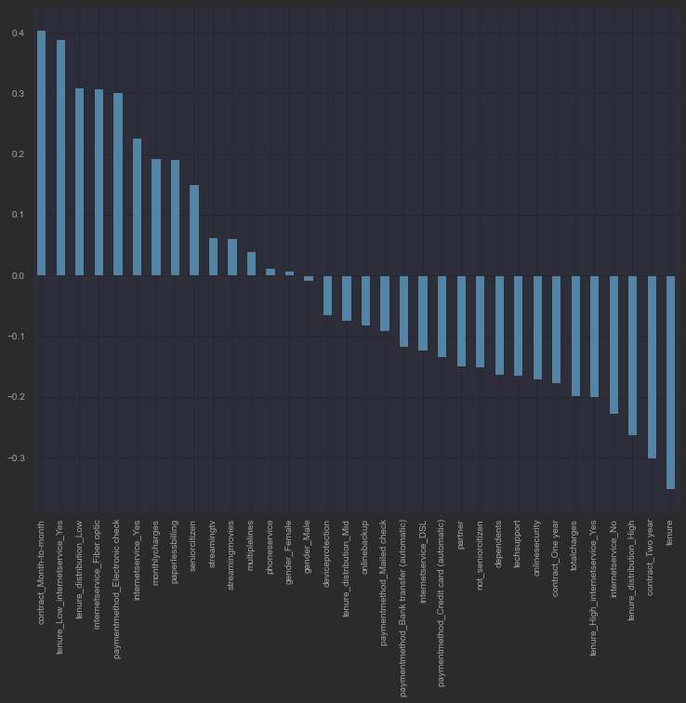
Data Description
Number Of Observations - 7043
Training Set Observations – 5634
Test Set Observations – 1409
Number of Features – 34 (after get dummies & feature engineering) - 1 of them is the label
Missing values - 11
Highest 3 positive correlation – contract_Month-to-month , tenure_Low_internetservce_Yes, tenure_distribution_Low
Highest 3 negative correlation – tenure, contract_Two year, tenure_distribution_High

Slide 4
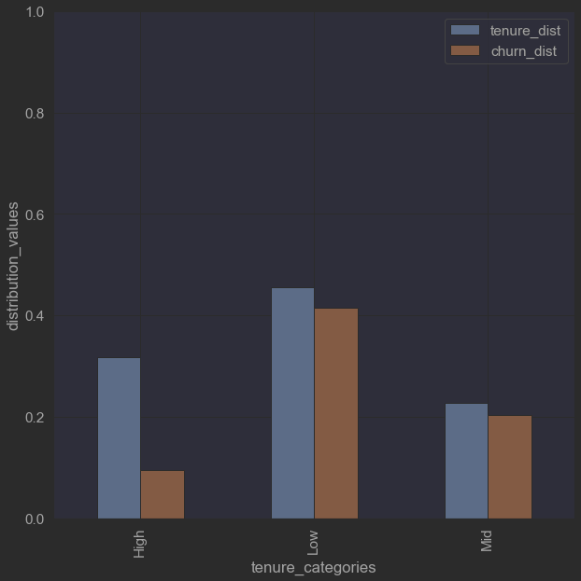
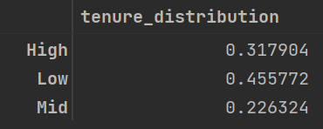
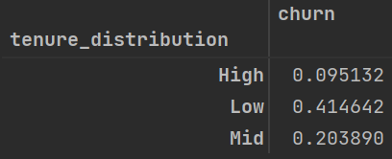
Churn & tenure distribution by tenure categories
Tenure distribution in months
Low : 0 - 24
Mid : 24 - 48
High : 48 +
Most tenure distribution is at the low category and then at the high category.
Highest churn distribution is at the low category and after at the mid.

Slide 5
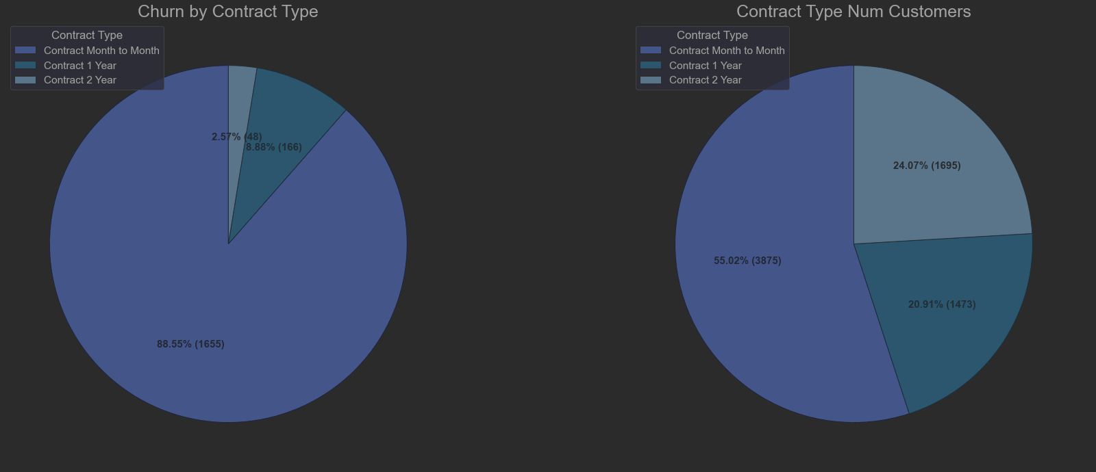
Churn & number of customers by contract type
Highest churned customers have month to month contract - 88.55% of churned customers.
The most popular contact is month to month contract 55.02% of customers has it
Then Contract 1 year with 24.07% of customers.

Slide 6
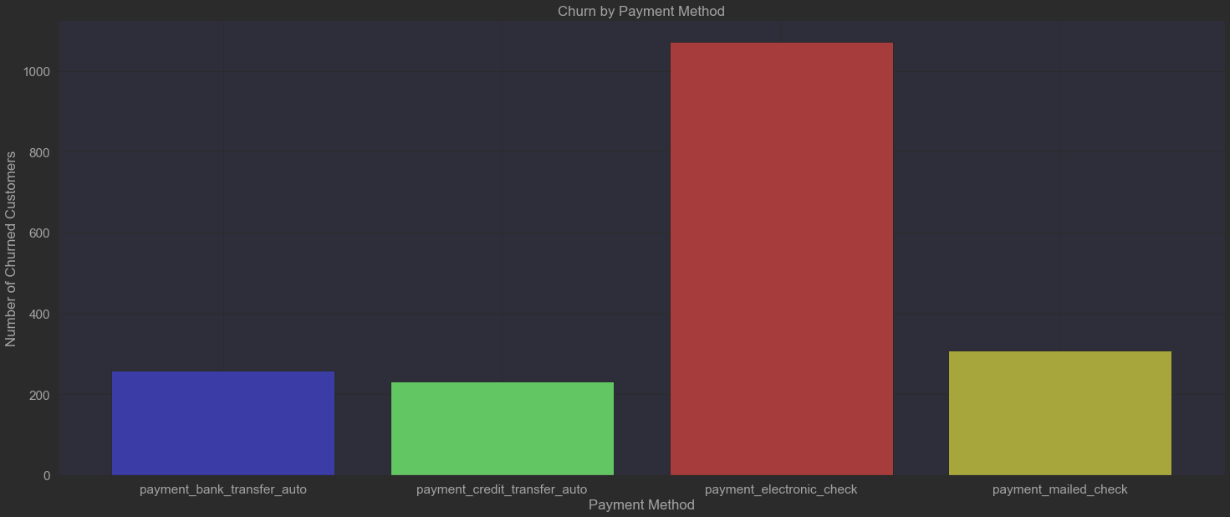
Number of Churned Customers By Payment Method
As we can see the payment method with the highest churned customers is payment by electronic check
The second highest which is close to the rest of the methods is payment by mailed check (automatic payments have less churn)

Slide 7
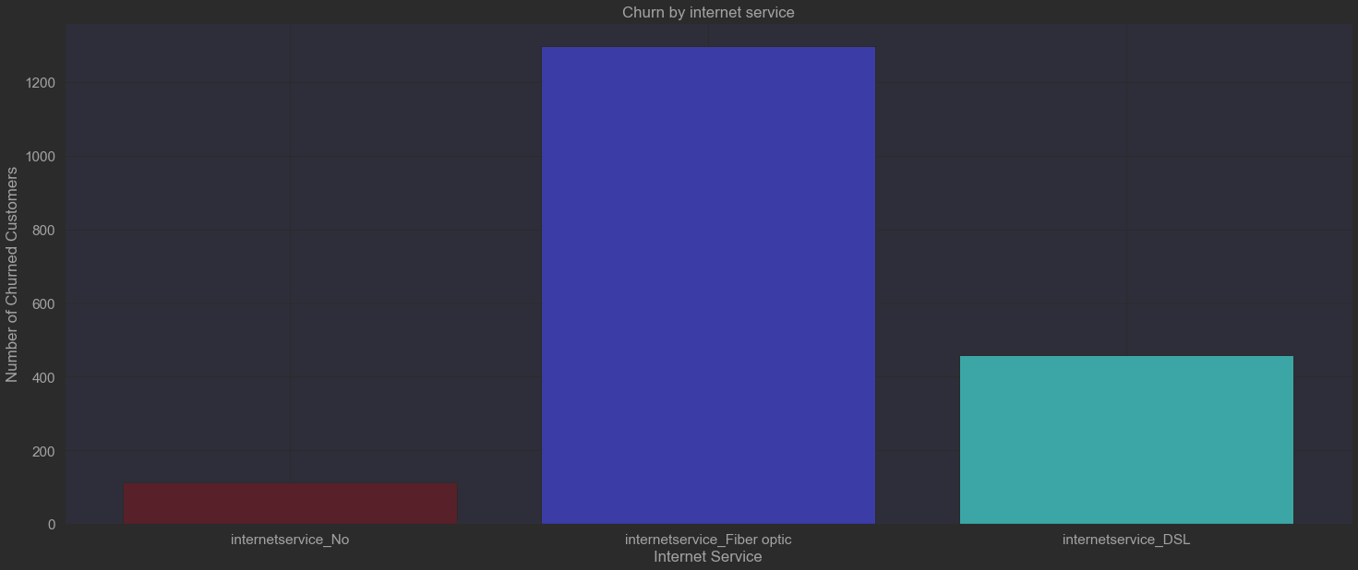
Number of Churned Customers By Internet Service
Customers with internet service fiber optic are most likely to churn, and customers with DSL internet service are in second place of most churned customers.

Slide 8
Data Engineering
Features added:
Categorial Features
gender split to -> gender_Male & gender_Female.
internetservice split to -> internetservice_Fiber optic, internetservice_DSL & internetservice_No.
contract split to -> contract_Month-to-month, contract_One year & contract_Two year.
payment method split to -> paymentmethod_Bank transfer (automatic), paymentmethod_Credit card (automatic), paymentmethod_Electronic check & paymentmethod_Mailed check.
tenure distribution split to -> tenure_distribution_Low, tenure_distribution_Mid & tenure_distribution_High.
Feature engineering added
not_seniorcitizen, internetservice_Yes, tenure_high_internetservice_Yes & tenure_low_internetservice_Yes .
Features Removed: customerid
There were 11 missing values in totalcharges column. We replaced them with the monthlycharges value respectively.

Slide 9

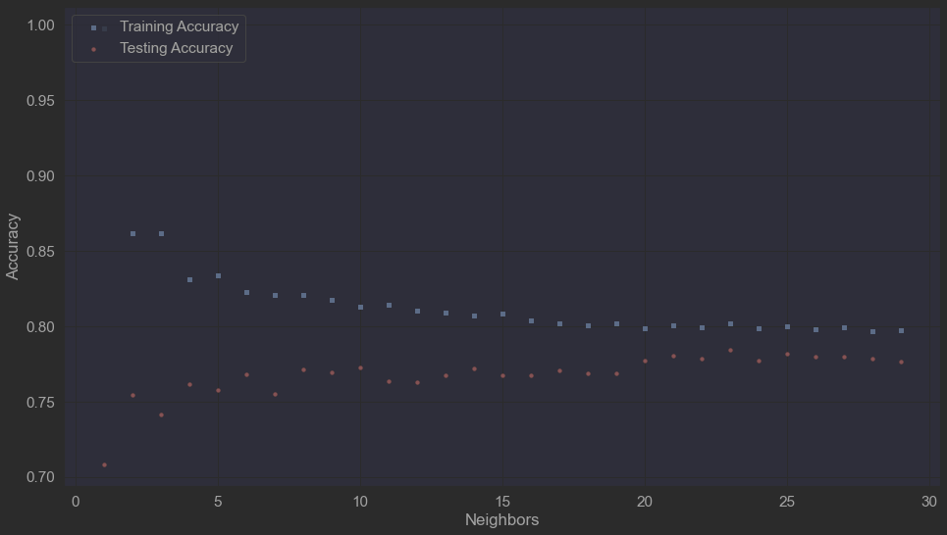
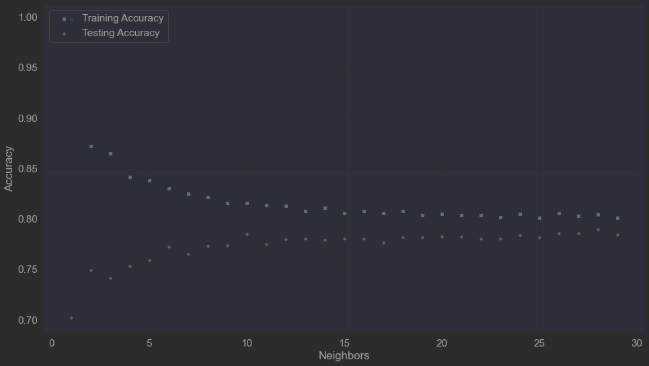
ML Algorithms
KNN - best K for testing accuracy is 23 (neighbors),and for overfitting perspective
K = 23 , test accuracy = 0.7842
Scaled KNN – best K for testing accuracy is 10 (neighbors),and for overfitting perspective
K = 10 , test accuracy = 0.7849
Notes:
i.e. avoiding the risk of wastage from extra inventory and the risk of being out of stock and lose potential costumers as a result.

Slide 10
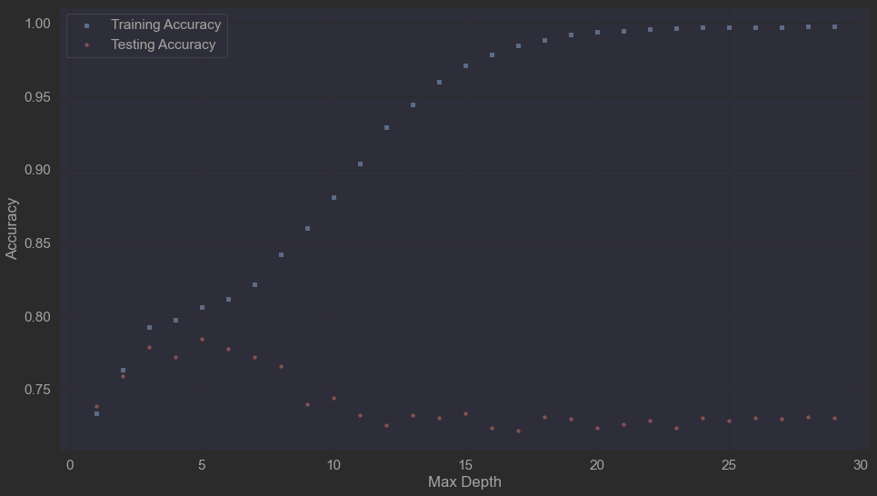
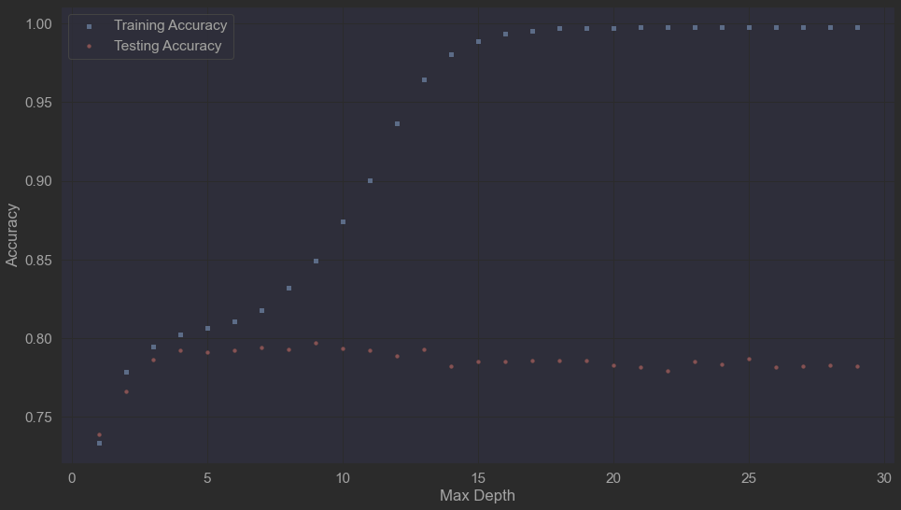
ML Algorithms
Decision Tree – best max _depth for testing accuracy is 5, and for overfitting perspective
max _depth = 5,
test accuracy = 0.7842
Random Forest – best max _depth for testing accuracy is 9, and for overfitting perspective
max _depth = 10,
test accuracy = 0.797
Notes:
i.e. avoiding the risk of wastage from extra inventory and the risk of being out of stock and lose potential costumers as a result.

Slide 11
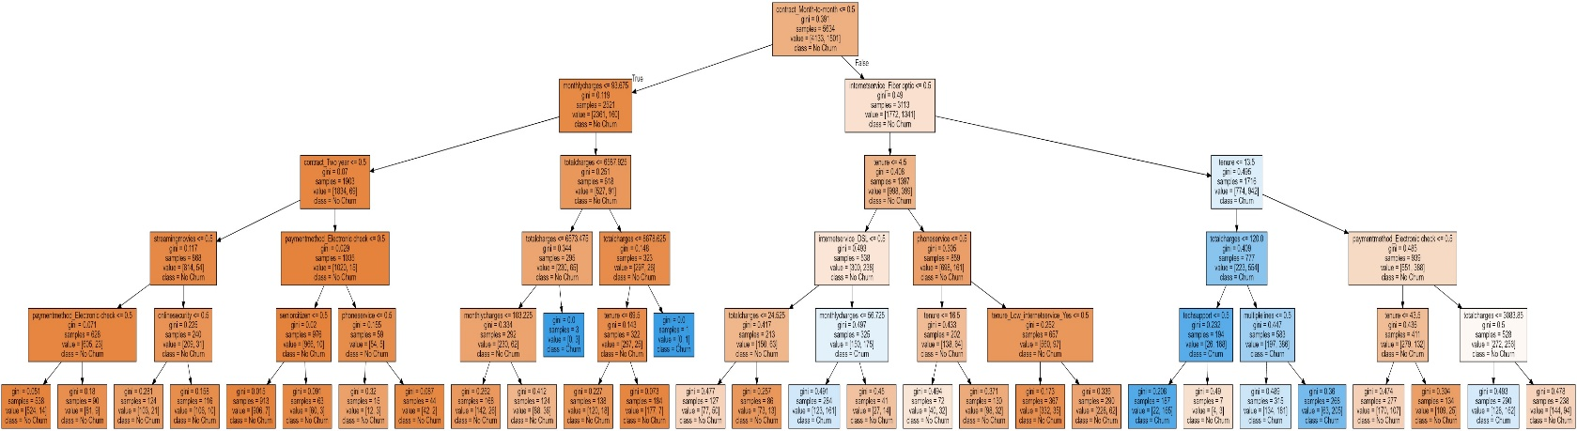
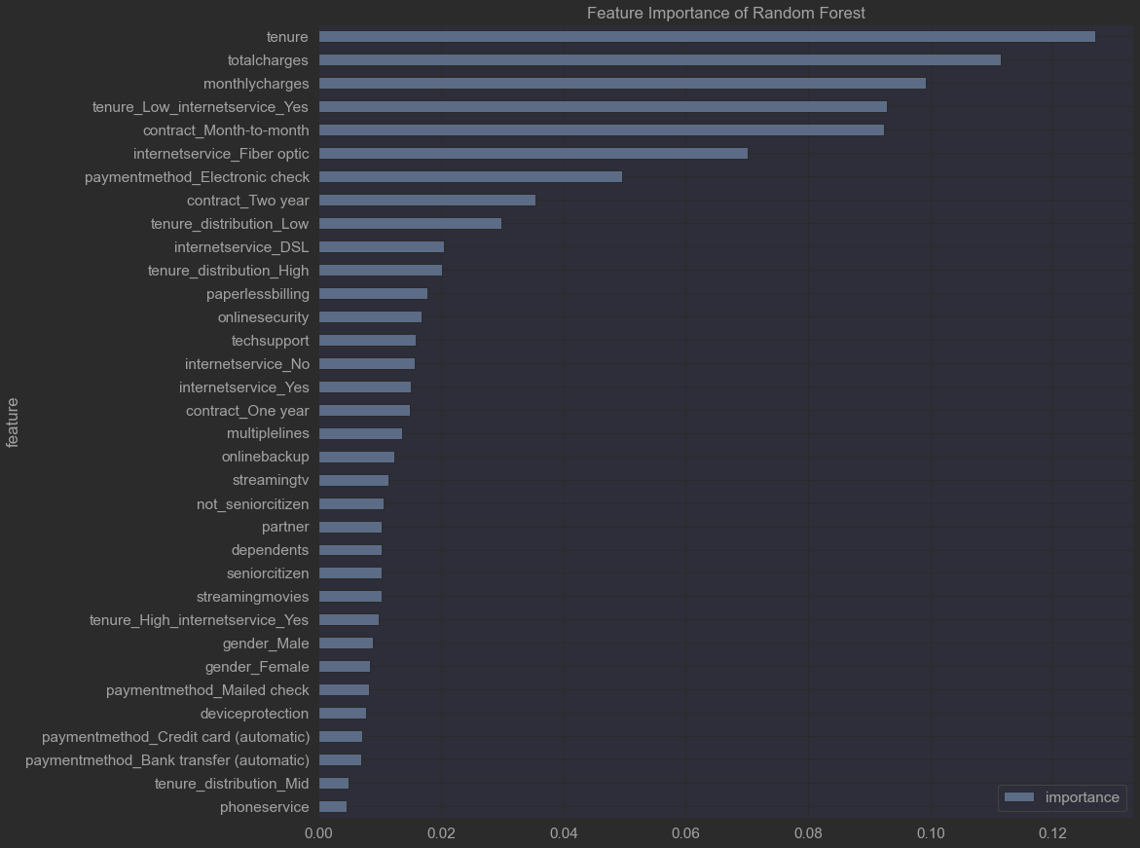
Algorithms introspection
Random Forest Important Feature
Top 3 important features of the algorithm are: tenure, totalcharges & monthlycharges.
Hyperparameters:
Notes:
i.e. avoiding the risk of wastage from extra inventory and the risk of being out of stock and lose potential costumers as a result.

